Slide 1

Async, Await, Oh… Wait!
You’d better watch your step December 2016 – Alt.Net Paris
@tpierrain (use case driven)

Slide 2
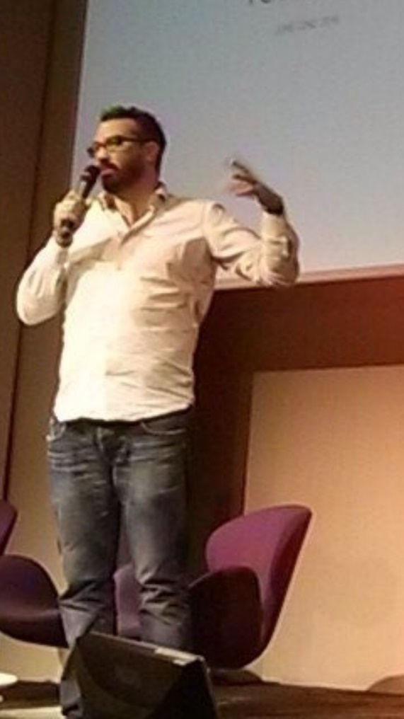

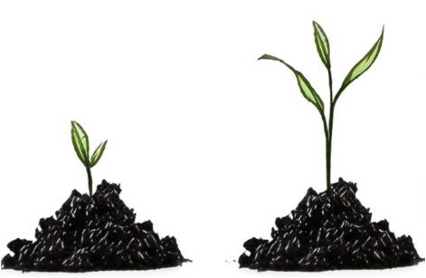

“Use Case Driven”, but also…
Reactive Programmer (> 10 years)
eXtreme Programmer (> 10 years)
Programmer (> 18 years)
NFluent
Value (DDD)
@tpierrain

Slide 3
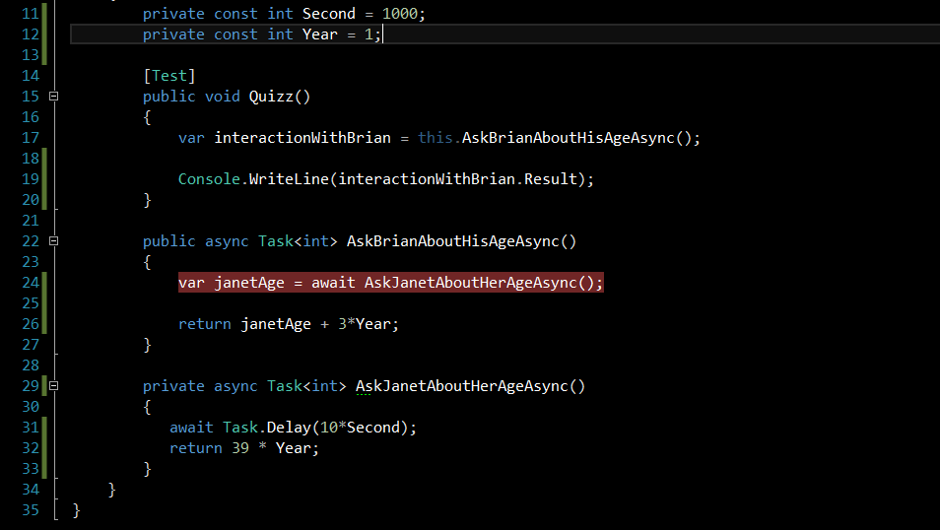
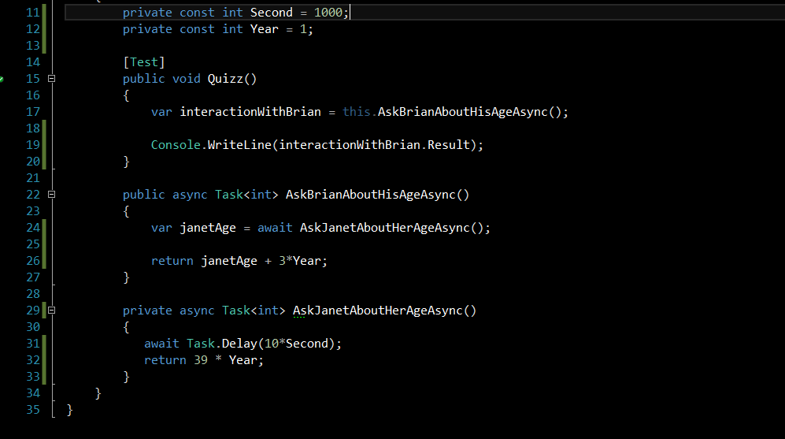
Let’s start with A question…

Slide 4
Let’s start with A question…
Q: What happens line 24, when await occurs?

Slide 5
Oups! Let’s Add some context

Slide 6
Let’s start with A question…
Q: What happens line 24, when await occurs?

Slide 7
Let’s start with A question…
Q: What happens line 24, when await occurs?

Slide 8
Let’s start with A question…
1

Slide 9
Let’s start with A question…
1

Slide 10
Let’s start with A question…
1

Slide 11
Let’s start with A question…
1

Slide 12
Let’s start with A question…
1

Slide 13
Let’s start with A question…
1

Slide 14
Let’s start with A question…
1

Slide 15

Let’s start with A question…
1
2

Slide 16
Let’s start with A question…
1
2

Slide 17
Let’s start with A question…
1
2

Slide 18
Let’s start with A question…
1
2

Slide 19
Let’s start with A question…
1
2

Slide 20
Let’s start with A question…
1
2

Slide 21
Let’s start with A question…
1

Slide 22
Let’s start with A question…
1
2

Slide 23
Let’s start with A question…
1
2

Slide 24
Let’s start with A question…
1
2

Slide 25
Let’s start with A question…
1
2

Slide 26
Let’s start with A question…
1
2

Slide 27
Let’s start with A question…
2
1

Slide 28
Let’s start with A question…
2
1
1

Slide 29
Let’s start with A question…
1

Slide 30
Let’s start with A question…
1

Slide 31
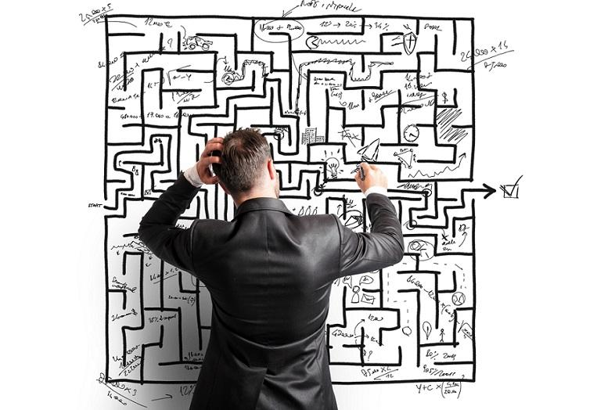
Was IT your first answer?
Replay?
Notes:
Ref: http://images.martechadvisor.com/images/uploads/content_images/cbc928ab5eb5e7f00676992442650b40.jpg

Slide 32

Guess what…
Same code in ASP.NET or UI Context
will deadlock!
Notes:
Ref:http://i.imgur.com/ZnREN.jpg

Slide 33
Async-Await Agenda
Why
What
How
Pitfalls & Recommendations

Slide 34
Chapter 1: Why

Slide 35
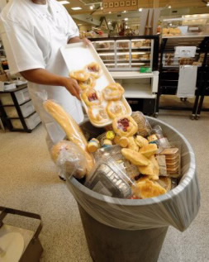
Like me, You don’t like Waste?
Notes:
Ref: http://blog.canacad.ac.jp/wpmu/15matser/files/2013/06/FoodWaste1.jpg

Slide 36
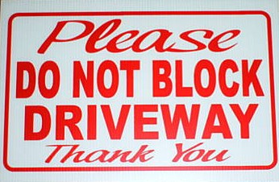
A simple rule to avoid waste of CPU

Slide 37
Async-await intention is...
…To easily transform
synchronous code ➔ asynchronous code
(Without hurting your existing code structure)

Slide 38
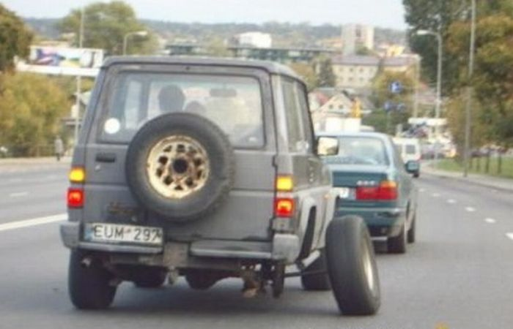
Without hurting your existing code structure
Notes:
Ref : http://www.careofcars.com/wp-content/uploads/2014/01/patchwork-on-cheap-cars.jpg

Slide 39

Wait a minute… Asynchronous, Concurrent, Parallel?
Notes:
Ref: http://ci.memecdn.com/7869512.jpg

Slide 40


synchronous
Asynchronous
Perform something here and now.
The caller thread will be blocked until it’s done
Initiate something here and now (off-loading).
The caller thread is released immediately
Free for something else
No waste of CPU resource ;-)
Notes:
Refs :
- https://cdn3.iconfinder.com/data/icons/basic-mobile-part-3/512/prisoner-512.png
- https://cdn4.iconfinder.com/data/icons/human-values-solid/100/_-62-512.png
- https://d30y9cdsu7xlg0.cloudfront.net/png/89995-200.png

Slide 41
synchronous
Asynchronous
Perform
Initiate
This is about invocation! (not about how the Goddamn thing is executed)
Notes:
Refs :
- https://cdn3.iconfinder.com/data/icons/basic-mobile-part-3/512/prisoner-512.png
- https://cdn4.iconfinder.com/data/icons/human-values-solid/100/_-62-512.png
- https://d30y9cdsu7xlg0.cloudfront.net/png/89995-200.png

Slide 42
What about execution

Slide 43
Concurrency
Multiple “threads” of execution
Independent logical segments
Notes:
Not OS threads
e.g.:
JavaScript in a browser
Node.js
e.g.:
Thread-based (e.g. multi-threading)
Task-based (e.g. TPL)

Slide 44
Concurrency
Parallelism
Multiple “threads” of execution
Independent logical segments
Concurrency + Simultaneous execution
Notes:
Not OS threads
e.g.:
JavaScript in a browser
Node.js
e.g.:
Thread-based (e.g. multi-threading)
Task-based (e.g. TPL)

Slide 45
Concurrency
Parallelism
Multiple “threads” of execution
Independent logical segments
Concurrency + Simultaneous execution
This is about Execution! (of the Goddamn thing ;-)
Notes:
Not OS threads
e.g.:
JavaScript in a browser
Node.js
e.g.:
Thread-based (e.g. multi-threading)
Task-based (e.g. TPL)

Slide 46
Chapter 2: What

Slide 47
Async-Await is…
Notes:
Refs :
- https://cdn3.iconfinder.com/data/icons/basic-mobile-part-3/512/prisoner-512.png
- https://d30y9cdsu7xlg0.cloudfront.net/png/89995-200.png

Slide 48
Asynchronous
Initiate something here and now (off-loading).
The caller thread is released immediately
I can use it for something else right now
No waste of CPU resource ;-)
Async-Await is…
Notes:
Refs :
- https://cdn3.iconfinder.com/data/icons/basic-mobile-part-3/512/prisoner-512.png
- https://cdn4.iconfinder.com/data/icons/human-values-solid/100/_-62-512.png
- https://d30y9cdsu7xlg0.cloudfront.net/png/89995-200.png

Slide 49
Asynchronous
Powered by Task Parallel Library
Async-Await is…
Notes:
Refs :
- https://cdn3.iconfinder.com/data/icons/basic-mobile-part-3/512/prisoner-512.png
- https://cdn4.iconfinder.com/data/icons/human-values-solid/100/_-62-512.png
- https://d30y9cdsu7xlg0.cloudfront.net/png/89995-200.png

Slide 50
Asynchronous
Powered by Task Parallel Library
Async-Await is About
“going Async”
“composing Async”
Notes:
Refs :
- https://cdn3.iconfinder.com/data/icons/basic-mobile-part-3/512/prisoner-512.png
- https://cdn4.iconfinder.com/data/icons/human-values-solid/100/_-62-512.png
- https://d30y9cdsu7xlg0.cloudfront.net/png/89995-200.png

Slide 51
Composing the Async
With Task continuations
Notes:
Refs :
- https://cdn3.iconfinder.com/data/icons/basic-mobile-part-3/512/prisoner-512.png
- https://d30y9cdsu7xlg0.cloudfront.net/png/89995-200.png

Slide 52
Chapter 3: How

Slide 53
(Prerequisite - TPL)

Slide 54
Task Parallel Library reminder (TPL)
Task
Continuation
CancelationToken
TaskCompletionSource

Slide 55
Task Parallel Library reminder (TPL)
Task
Continuation
CancelationToken
TaskCompletionSource

Slide 56
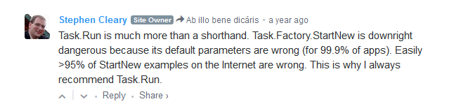
Task Parallel Library reminder (TPL)
Task
Continuation
CancelationToken
TaskCompletionSource
Task
3 ways to instantiate and run a Task:
var task = Task.Run(lambda);
var task = new Task(lambda).Start();
Task.Factory.StartNew(lambda);
task.Wait(), task.Result & task.Exception ( all blocking ;-(

Slide 57
Task Parallel Library reminder (TPL)
Task
Continuation
CancelationToken
TaskCompletionSource
Continuation
A Task that will be achieve once a previous Task has finished
var continuationTask = previousTask.ContinueWith(lambda);
PreviousTask
ContinuationTask

Slide 58
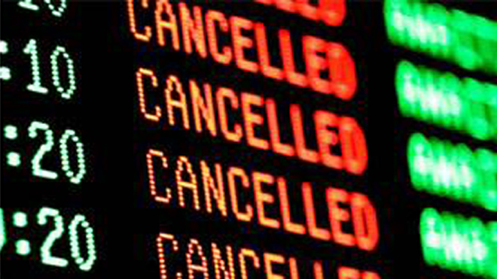
Task Parallel Library reminder (TPL)
Task
Continuation
CancelationToken
TaskCompletionSource
CancelationToken
Notes:
Ref : http://www.theyeshivaworld.com/wp-content/uploads/2014/07/can.jpg

Slide 59
Task Parallel Library reminder (TPL)
Task
Continuation
CancelationToken
TaskCompletionSource
TaskCompletionSource
Developer to control the lifetime and completion of the associated Task

Slide 60
Async-Await

Slide 61
Async-Await
A Compiler thing – syntaxic sugar
Generated State machine
S
TaskAwaiter

Slide 62
Await
Marks a continuation (with proper context)
Returns to the caller with a task
Which is a reference to the ongoing work

Slide 63
Who’s doing the continuation?
Well… it depends ;-)

Slide 64
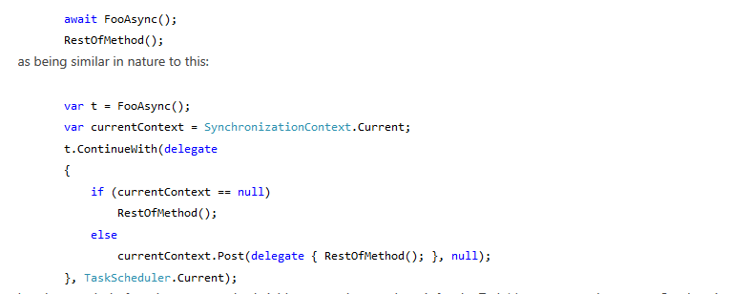
It depends on the awaiter context
The following code:
Is equivalent to:
WinForms,
WPF,
ASP.NET…

Slide 65

Windows I/O: under the hood
Notes:
Ref: https://static1.squarespace.com/static/544d2af6e4b007f43083a5b0/544e719be4b07c493b25c4e4/54625440e4b0f79db69b3b1a/1417724183061/?format=1500w

Slide 66
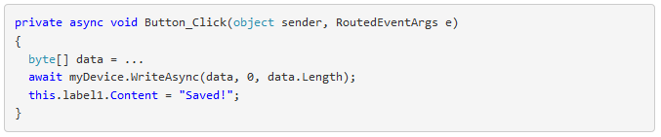
Windows I/O: under the hood

Slide 67
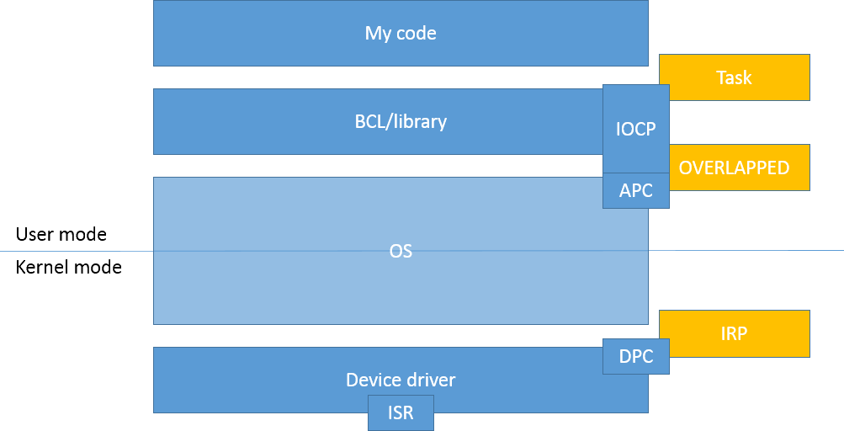
Windows I/O: under the hood
User mode
Kernel mode

Slide 68
Windows I/O: under the hood
UI thread
User mode
Kernel mode

Slide 69
Windows I/O: under the hood
BCL.WriteAsync()
User mode
Kernel mode

Slide 70
Windows I/O: under the hood
P/Invoke handle
User mode
Kernel mode

Slide 71
Windows I/O: under the hood
User mode
Kernel mode
Create I/O Request Packet (IRP)
(asynchronous)

Slide 72
Windows I/O: under the hood
Return Task (await)
User mode
Kernel mode

Slide 73
Windows I/O: under the hood
Release UI thread
User mode
Kernel mode

Slide 74

Windows I/O: under the hood
User mode
Kernel mode
(No thread)

Slide 75
Windows I/O: under the hood
User mode
Kernel mode
Interrupt!
(No thread)

Slide 76

Windows I/O: under the hood
User mode
Kernel mode
Interrupt Service Routine (ISR)
(No thread)

Slide 77
Windows I/O: under the hood
User mode
Kernel mode
Queue
Deferred Procedure Call (DPC).
(No thread)

Slide 78
Windows I/O: under the hood
User mode
Kernel mode
Mark IRP
as completed
(No thread)

Slide 79
Windows I/O: under the hood
Create Asynchronous Procedure Call (APC)
to notify the UI process (handle)
User mode
Kernel mode
(No thread)

Slide 80
Windows I/O: under the hood
Execute
APC via I/O Completion port (IOCP) thread
User mode
Kernel mode

Slide 81
Windows I/O: under the hood
Execute
APC via I/O Completion port (IOCP) thread
User mode
Kernel mode

Slide 82
Windows I/O: under the hood
Post the continuation for UI thread execution
User mode
Kernel mode

Slide 83
Windows I/O: under the hood
User mode
Kernel mode

Slide 84
Windows I/O: under the hood
Execute continuation (UI thread)
User mode
Kernel mode

Slide 85
Windows I/O: under the hood
Execute continuation (UI thread)
User mode
Kernel mode

Slide 86

Windows I/O: under the hood
User mode
Kernel mode

Slide 87
Chapter 4: Pitfalls & Recos

Slide 88

Not that simple…
Notes:
Ref: http://www.designnation.de/Media/Galerie/50cf9c1d197e0,Houston-we-have-a-problem.jpg

Slide 89
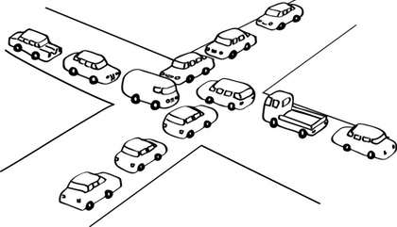
Deadlocks

Slide 90
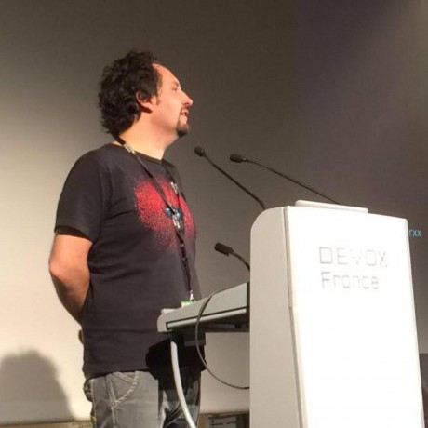
The dupdob principle
“Qui dit lockS… dit deadlocks”
“whoever locks… eventually deadlocks”
@cyrdup
Notes:
Ref: https://avatars1.githubusercontent.com/u/3131866?v=3&s=460

Slide 91
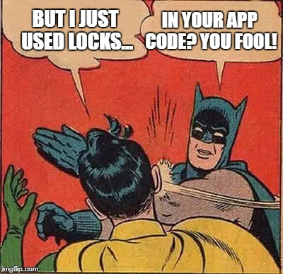
Deadlock Meme
Notes:
Ref: http://ci.memecdn.com/7869512.jpg

Slide 92
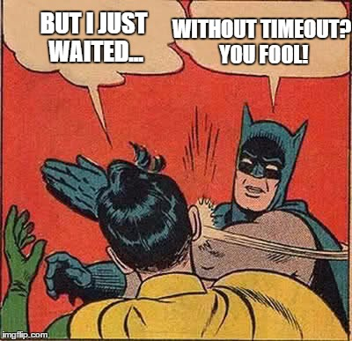
Deadlock Meme
Notes:
Ref: http://ci.memecdn.com/7869512.jpg

Slide 93
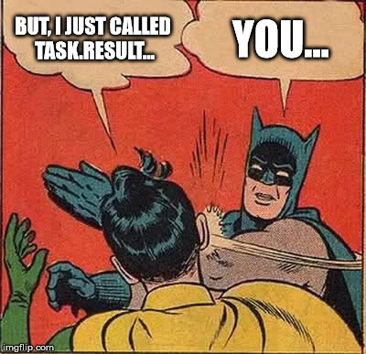
Deadlock Meme
Notes:
Ref: http://ci.memecdn.com/7869512.jpg

Slide 94
Wrap-up

Slide 95
Appendix

Slide 96
Async method GC impact
3 allocations for every Async method
Heap-allocated state machine
With a field for every local variable in your method
Completion delegate
Task

Slide 97
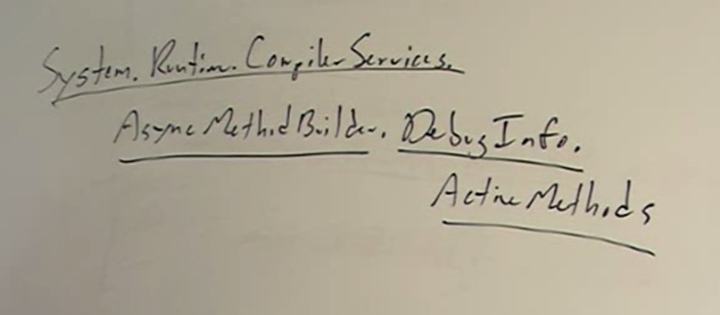
Troubleshooting?
Namespace
public type
nested type
static method

Slide 98
Few refs
Async-Await Best practices: https://msdn.microsoft.com/en-us/magazine/jj991977.aspx
Compiler error: http://stackoverflow.com/questions/12115168/why-does-this-async-await-code-generate-not-all-code-paths-return-a-value
Task.Run etiquette: http://blog.stephencleary.com/2013/11/taskrun-etiquette-examples-dont-use.html
There is no thread: http://blog.stephencleary.com/2013/11/there-is-no-thread.html
Does using Tasks (TPL) library make an application multithreaded? : http://stackoverflow.com/questions/23833255/does-using-tasks-tpl-library-make-an-application-multithreaded
Async-Await best practices: https://msdn.microsoft.com/en-us/magazine/jj991977.aspx

Slide 100
Two Content Layout with Table
First bullet point here
Second bullet point here
Third bullet point here
Class | Group 1 | Group 2
Class 1 | 82 | 95
Class 2 | 76 | 88
Class 3 | 84 | 90

